Slide 1

MINI PROJECT
SUBMITTED IN PARTIAL FULFILLMENT OF THE REQUIREMENTS TO
RGUKT SRIKAKULAM
For the award of the degree B.Tech (AY 2021-2025) In
COMPUTER SCIENCE AND ENGINEERING
Submitted by
S191113 - M.Ramani Priya , S191119 - P.Mohitha
S190934 - K.Anusha , S191130 - S.Bhanu , S190261 - G.Asha
Under the Esteemed Guidance of
Mrs.Ch.Lakshmi Bala, Assistant professor

Slide 2
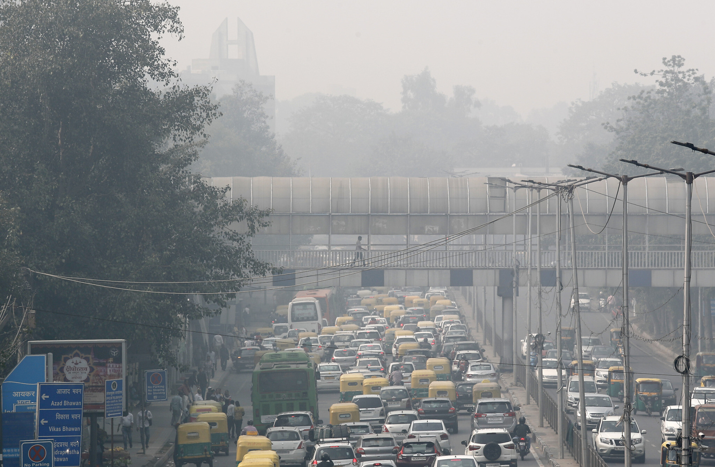
IMPACT OF ETHER ON VULNERABLE GROUPS

Slide 3
PROBLEM STATEMENT
The atmosphere, influenced by factors such as pollution, climate change, and natural disasters, has a significant impact on vulnerable groups within society. These groups, including the elderly, children, low-income communities, and individuals with pre-existing health conditions, face heightened risks and challenges.Environmental changes can make a situation like health issues, disrupt livelihoods, and increase socio-economic inequalities.This project aims to identify and categorize these vulnerable groups more precisely and propose targeted measures to better protect and support them in the face of atmospheric changes.

Slide 4
ABSTRACT
This project aims to develop a web application that provides health impact information based on the Air Quality Index (AQI) input provided by users. The Air Quality Index (AQI) measures how clean or polluted the air is based on levels of pollutants like Carbon Monoxide (CO), Nitrogen Dioxide (NO2), Ozone (O3), and Fine Particulate Matter (PM2.5). It specifically looks at vulnerable groups such as people with breathing problems, heart conditions, older adults, and children, and how their health is influenced by various AQI thresholds .Our goal is to raise awareness and promote efforts to create a healthier environment for everyone.
Air Quality Index(AQI) ,Health Impact, Vulnerable Groups,Pollution Awareness,AQI Thresholds, Public Health, Fine Particulate Matter (PM2.5), Carbon Monoxide (CO),Nitrogen Dioxide (NO2),Ozone (O3),
Keywords :

Slide 5
INTRODUCTION
Air pollution, climate change, and natural disasters are critical environmental challenges that significantly impact public health and well-being. Vulnerable groups such as the elderly, children, low-income communities, and individuals with pre-existing health conditions are particularly susceptible to these atmospheric changes. These environmental factors not only exacerbate health issues but also disrupt livelihoods, leading to increased socio-economic inequalities. Current air quality monitoring systems provide general information through the Air Quality Index (AQI), but they lack specificity in addressing the unique needs of these vulnerable populations. This project aims to fill this gap by developing a system that identifies and categorizes these vulnerable groups based on AQI levels and other environmental factors

Slide 6
Through the integration of a user-friendly frontend and a robust backend powered by Python Flask, this project offers a comprehensive approach to air quality monitoring. It delivers critical insights and actionable information, enabling individuals and communities to make informed decisions to safeguard their health and well-being in the face of environmental challenges.This project aims to develop a system that precisely identifies and categorizes vulnerable groups, offering targeted measures and resources to better protect and support them against atmospheric changes. By combining a user-friendly frontend with a Python Flask backend, this project provides essential insights and actionable information to help safeguard these groups' health and well-being.

Slide 7
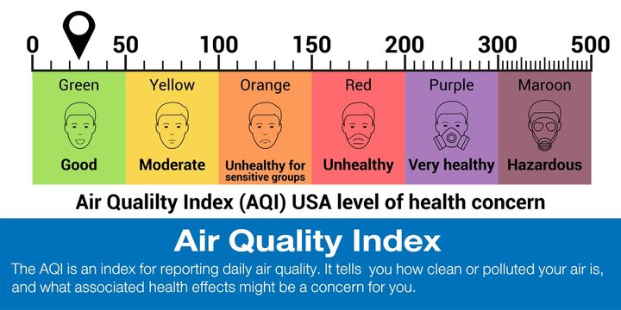

Slide 8
EXISTING SYSTEM
The current Air Quality Monitoring System uses the K-Nearest Neighbors (KNN) algorithm to figure out the air quality status, like whether it is good, moderate, or unhealthy, based on the Air Quality Index (AQI). The system gathers data from sensors that measure pollutants like PM2.5, ozone, nitrogen dioxide, and carbon monoxide. This data is used to calculate the AQI. The KNN algorithm, a type of machine learning, is trained with past data that has already been categorized into different air quality levels. When new data comes in the algorithm compares it to the closest matches in the existing data to determine the current air quality status.This system helps by providing up-to-date information about the air quality, which can alert people and help them take precautions if the air quality is bad.

Slide 9
ALGORITHMS USED :
KNN : K-Nearest Neighbors (KNN) is used for classification and regression tasks, where it predicts the class or value of a new data point based on the majority class or average value of its nearest neighbors in the feature space. It's particularly effective in scenarios with well-defined clusters or patterns in the data.
DISADVANTAGES :
Inaccuracy: Current methods for estimating AQI may lack precision, leading to inaccurate predictions.
Result: It does not tell which diseased people are effected.

Slide 10
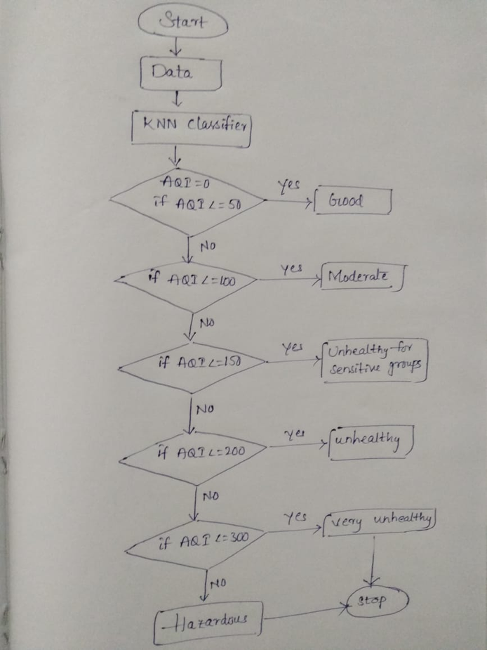
Work Flow

Slide 11
PROPOSED SYSTEM
In our proposed system,not only determines the air quality status as good, moderate, or unhealthy but also specifies the vulnerable groups most likely to be impacted within different AQI ranges. For AQI values of 0-50, the system identifies that no effect to the people but people with asthma, chronic bronchitis, other respiratory conditions, pregnant women, and children are most at mild risk. For AQI values between 51-100, individuals with heart disease or other cardiovascular conditions, as well as outdoor workers and athletes who spend significant time outdoors, are highlighted. In the AQI range of 101-150, the system focuses on older adults and those experiencing hypertension, chest pain, palpitations, or shortness of breath. When AQI values reach 151-200, it indicates higher risks for those with Chronic Obstructive Pulmonary Disease (COPD), allergic rhinitis, throat irritation, and other respiratory diseases.

Slide 12
Finally, for AQI values above 200, the system alerts that people with asthma, COPD, and bronchitis are severely affected.This enhancement allows the system to provide more detailed and actionable health advisories, helping specific vulnerable groups take necessary precautions during periods of poor air quality.
Algorithms Used :
KNN : K-Nearest Neighbors (KNN) is used for classification and regression tasks, where it predicts the class or value of a new data point based on the majority class or average value of its nearest neighbors in the feature space. It's particularly effective in scenarios with well-defined clusters or patterns in the data.

Slide 13
ADVANTAGES
Targeted Health Advisories: By identifying specific vulnerable groups affected by different AQI ranges, the system provides targeted health advisories, allowing people to take more effective precautions.
Enhanced Public Awareness: It raises awareness about the impact of air quality on various health conditions, helping communities understand the risks better.
Resource Allocation: Authorities can allocate medical and emergency resources more effectively during periods of poor air quality, focusing on the most affected groups.
Improved Overall Health Outcomes: Ultimately, the system helps improve overall public health outcomes by minimizing exposure to harmful air pollutants and preventing related health issues.

Slide 14
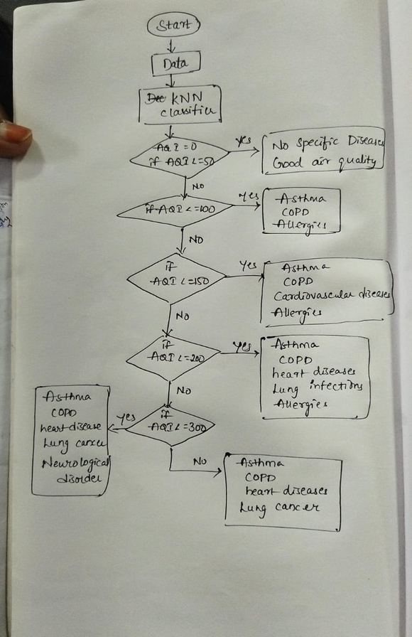
Work Flow

Slide 15
LITERATURE SURVEY
Air Quality Index (AQI) looks at how we measure and report air pollution levels to the public. The AQI uses data from sensors and satellites to track pollutants like dust and gases in the air. It simplifies this data into a single number or rating, helping people understand if the air is clean or polluted. Different countries have their own rules for what levels are safe or dangerous. Scientists are always studying air quality to find better ways to measure it and understand how it affects our health and environment. This research helps us make decisions to keep our air cleaner and healthier for everyone.Air quality has a big impact on vulnerable groups like children, elderly people, and those with existing health problems. For kids, breathing in pollutants like PM2.5 and ozone can lead to more asthma attacks and other respiratory issues.

Slide 16
Older adults with heart or lung conditions are also at risk, as air pollution can worsen their health and lead to more hospital visits. People with asthma or other chronic illnesses can have their symptoms flare up when the air is polluted with things like ozone or carbon monoxide. Even communities with less money often face worse air quality because of where they live. To help, it's important to improve air monitoring, educate people about risks, and make sure everyone has access to clean air.

Slide 17
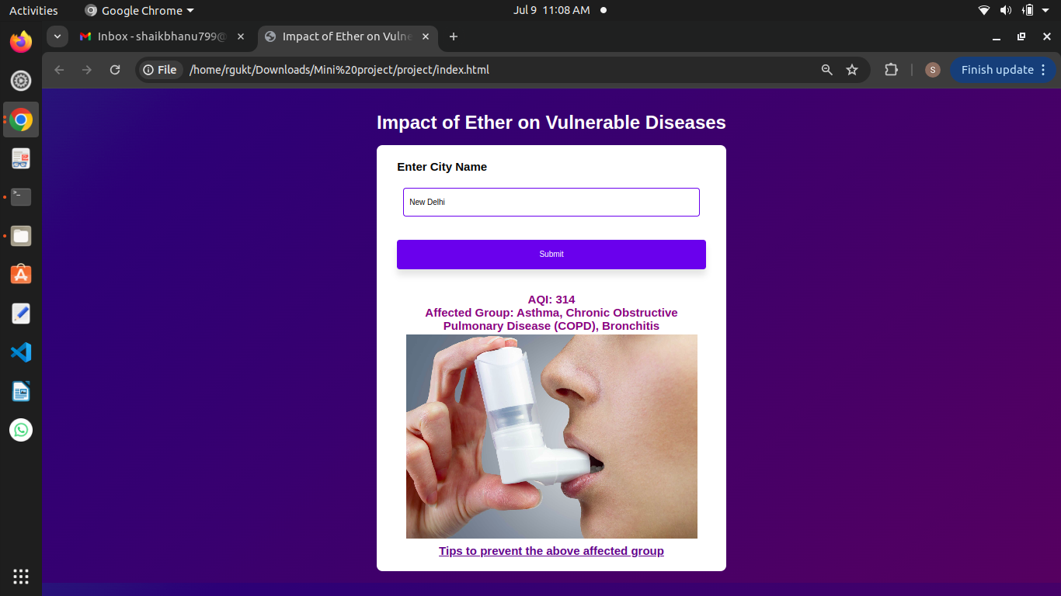
OUTPUT

Slide 18
REFERENCES
https://ieeexplore.ieee.org/document/9915802
https://www.kaggle.com/datasets/sazidthe1/global-air-pollution-data/data
https://www.unep.org/interactives/air-pollution-note/
https://www.niehs.nih.gov/health/topics/agents/air-pollution
https://www.who.int/data/gho/data/themes/theme-details/GHO/air-pollution

Slide 19


